Slide 1
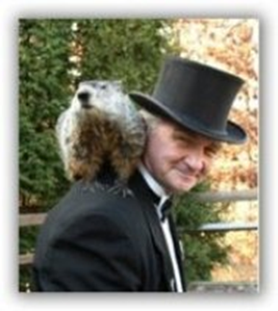
GROUNDHOG
DAY

Slide 2
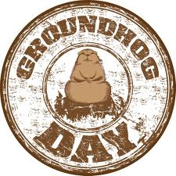
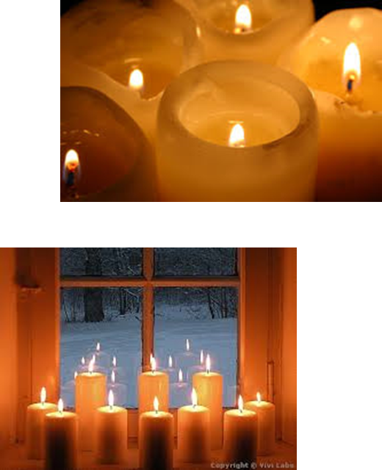
ORIGIN
When German settlers arrived in the 1700s, they brought a tradition known as Candlemas Day, which has an early origin in the pagan celebration of Imbolc
It came at the mid-point between the Winter Solstice and the Spring Equinox. Superstition held that if the weather was fair, the second half of Winter would be stormy and cold.

Slide 3
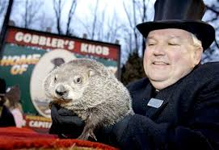
The day's weather continued to be important. If the sun came out on February 2, halfway between Winter and Spring, it meant six more weeks of wintry weather.

Slide 4
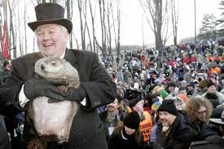
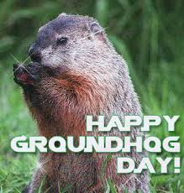
OFFICIAL CELEBRATION
Pennsylvania's official celebration of Groundhog Day began on February 2nd, 1886 with a proclamation in The Punxsutawney Spirit by the newspaper's editor, Clymer Freas: "Today is groundhog day and up to the time of going to press the beast has not seen its shadow."

Slide 5
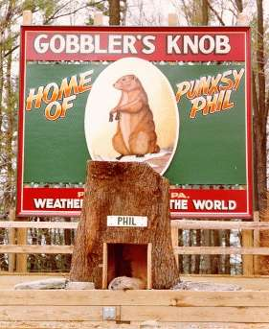
THE NAME
The groundhog was given the name "Punxsutawney Phil and the Weather Prophet.
Thus, his hometown is called the "Weather Capital of the World.'’
The refrain says: ”no shadow - early Spring”.

